Slide 1
New M240B Discriminator
Wesston Dana

Slide 2
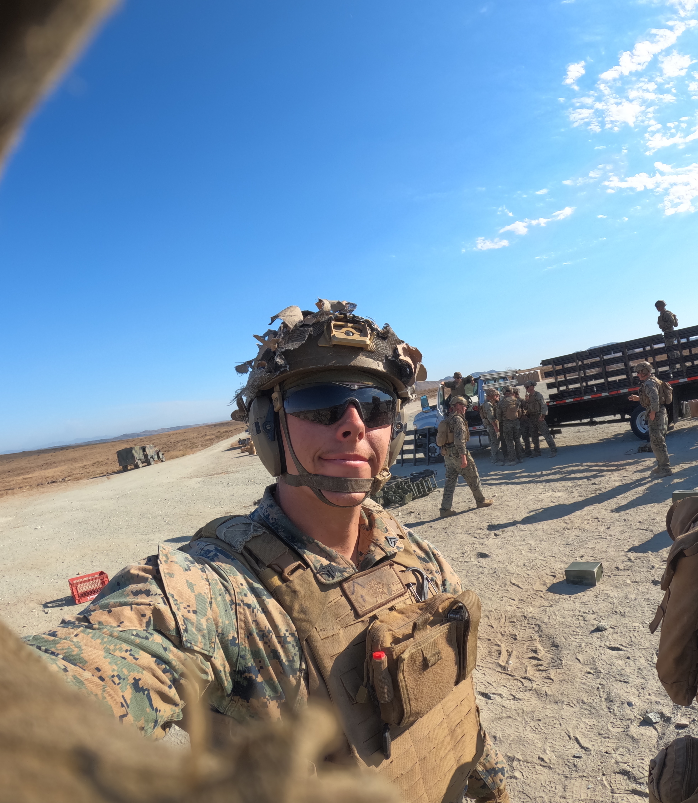
Technical Background
I served as a United States Marine as an Infantry Machine Gunner for four years with one deployment to the Middle East and one to Okinawa, Japan. I attended and graduated "Advanced Machine Gunners School" and have mastered knowledge and techniques when it comes to machine guns.

Slide 3
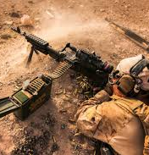
Description
For my SIP, I am proposing a new feed tray for the M240B that will reduce the frequency of interruptions in the cycle of operations and allow for more effective and realistic training for the military.

Slide 4
Innovation Claim
Once I presented my SIP idea to Mack Kiihnl, a veteran who has seen combat and has dealt with the same issues, his definition of innovation is as follows:
"...innovation in relation to the military should be something new or something that improves an aspect of training or combat."

Slide 5

Target Market
The target market for this idea is the US military and her trusted allies.

Slide 6
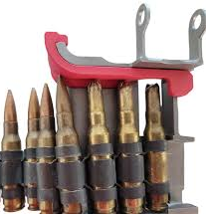
Prior Art
A product that is similar to my idea is the “240 BFD (Blank Feed Tray Discriminator)”. This discriminator is an external piece that that latches onto the feed tray that does not allow for a live round to be loaded and fired and allows for the blank ammunition to seat properly.

Slide 7
Work that still needs to be done
Create a 3D print prototype (attached)
1
Mesh the feed tray and discriminator prints
2
Ensure dimensions are correct
3
Make final prototype out of steel and begin production
4

Slide 8
Prototype and Timeline
I believe that we can get a 3D printed prototype within a month and then we can test to ensure it seats properly and all the dimensions match. From there, we can find a manufacture that can help us take the next step and make it out of steel. I predict that can take up to 3 months.

