Slide 1
New M240B Discriminator
Wesston Dana

Slide 2
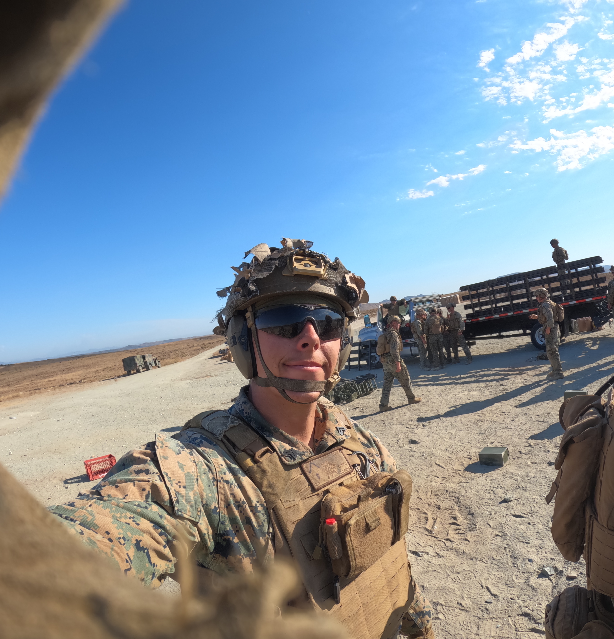
Technical Background
I served as a United States Marine as an Infantry Machine Gunner for four years with one deployment to the Middle East and one to Okinawa, Japan.
  Early promotion to "Team Leader" role
  AMGC Graduate
  Awarded a Meritorious Mast for teaching machine gun employment and techniques to soldiers in Qatar
  This idea comes from years of hands-on experience operating, maintaining, and teaching the M240B—not from theory.

Slide 3
The Problem
Military units frequently train with blank ammunition.
Blank rounds feed differently than live ammunition.
Existing feed trays were originally designed around live ammunition.
During training, machine guns can experience interruptions that slow training and create frustration.
Every interruption means:
  lost training time
  less realistic drills
Current equipment was never optimized specifically for blank ammunition training.

Slide 4
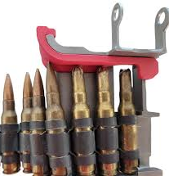
Prior Art
A product that is similar to my idea is the “240 BFD (Blank Feed Tray Discriminator)”. This discriminator is an external piece that that latches onto the feed tray that does not allow for a live round to be loaded and fired and allows for the blank ammunition to seat properly.
External attachment
Adds extra component
Doesn't redesign the actual feed tray
Doesn't fully address feeding consistency

Slide 5
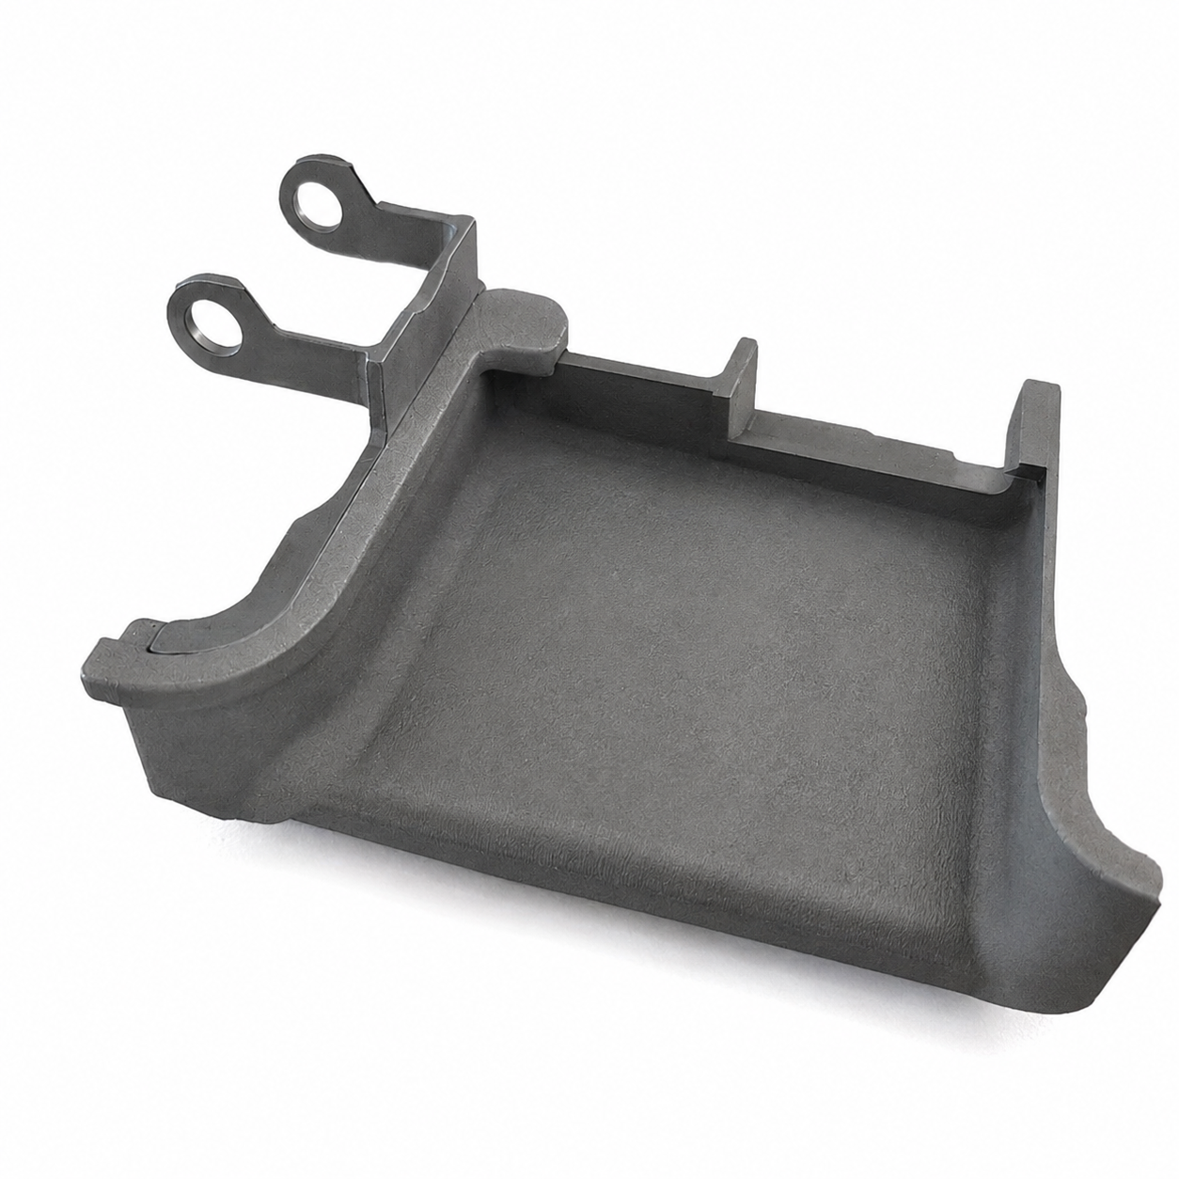
Blank Firing Adapter Feed Tray
My redesigned feed tray incorporates a built-in discriminator that improves blank ammunition alignment during feeding. By integrating the discriminator directly into the feed tray, the system has fewer external components while improving reliability during blank-fire training.
Fewer feeding interruptions
More realistic training
Faster training evolution
Less instructor downtime
No external attachment required

Slide 6

Innovation Claim
Current System | My Design
External discriminator | Integrated discriminator
More Parts | Fewer parts
Interruptions still occur | Designed to reduce interruptions
Existing Design (Cheap Plastic) | New Feed Tray concept (Stainless Steel)
"...innovation in relation to the military should be something new or something that improves an aspect of training or combat." -Mack Kiihnl

Slide 7

Target Market
The target market for this idea is the US military and her trusted allies.
United States Army
United States Marine Corps
National Guard
Reserve Components
NATO partners
Military training schools
Foreign Military Sales partners

Slide 8
Prototype and Timeline
3D Print design is 90% done
Month 1
  Print prototype
Month 2
  Fit testing
Month 3
  Live evaluation
Month 4-6
  Steel manufacturing

Slide 9
Why This is Important
Impact
  Improves military readiness
  Saves training time
  Reduces weapon interruptions
  Builds more realistic machine gun training
  Can be fielded across thousands of existing M240B systems
  Small engineering improvements can produce significant gains in military readiness. My goal is to solve a problem I experienced firsthand while serving as a Marine machine gunner.

